Slide 1
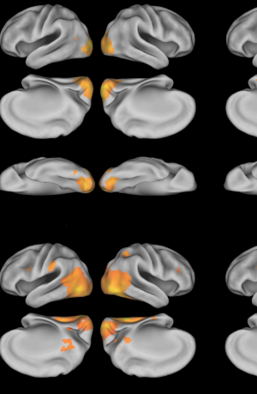

fMRI – DNNs gigantic mouses
Cichy, R. et al. 2016
Katherine Baquero, Alexander Enge, Manshan Guo,
Fabian Renz & Regina Zaghi-Lara
Steven Scholte – Mentor
Tejas Savalia – Project TA
Patrick Boak – Tutorial TA

Slide 2
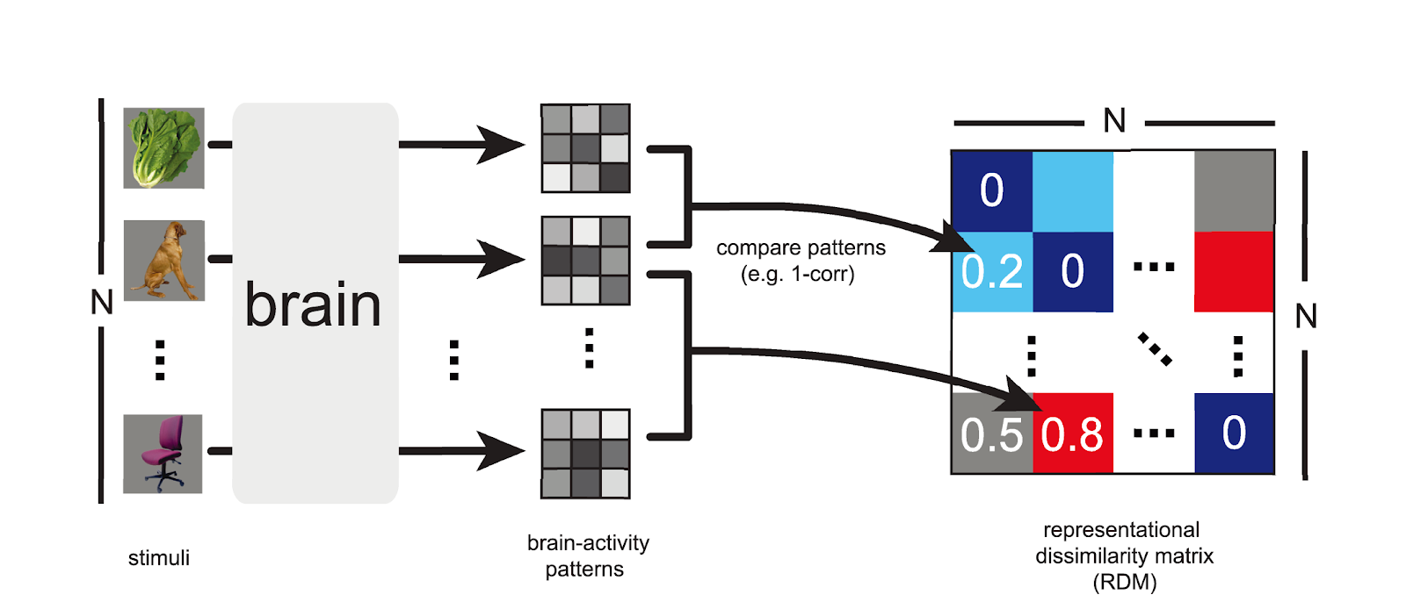
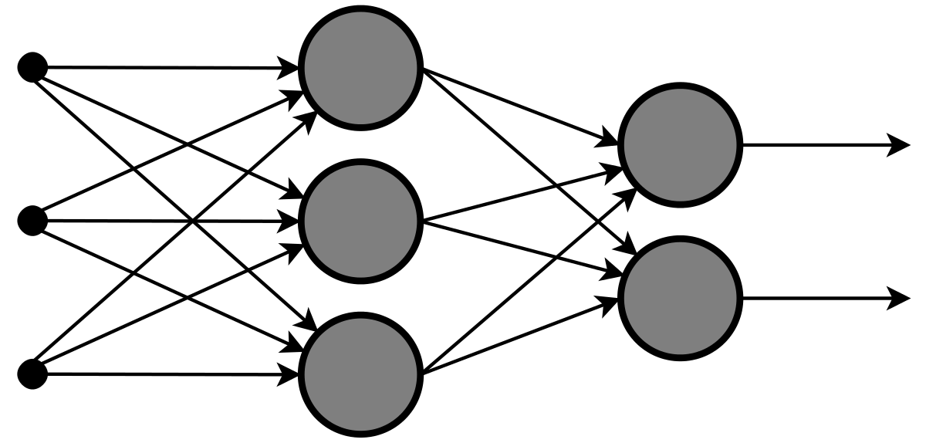
Deep Neural Networks (DNNs)

Slide 3
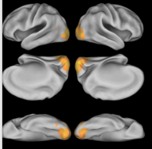
Question
To what extent can we capture neural representations measured by fMRI in early visual cortex (EVC) & inferior temporal gyrus (IT) using deep neural networks (DNNs)?
Hypotheses:
Deep neural networks show a similar structure to the human visual system. Thus, early layers in DNNs are more important for EVC description, while late layers contain more information about IT activity
Deeper networks are able to capture the neural representations better as indicated by more explained variance
Exploratory: Compare different learning types of DNNs; classical supervised (AlexNet & ResNets) & self-supervised (Momentum Contrast – MoCo)

Slide 4
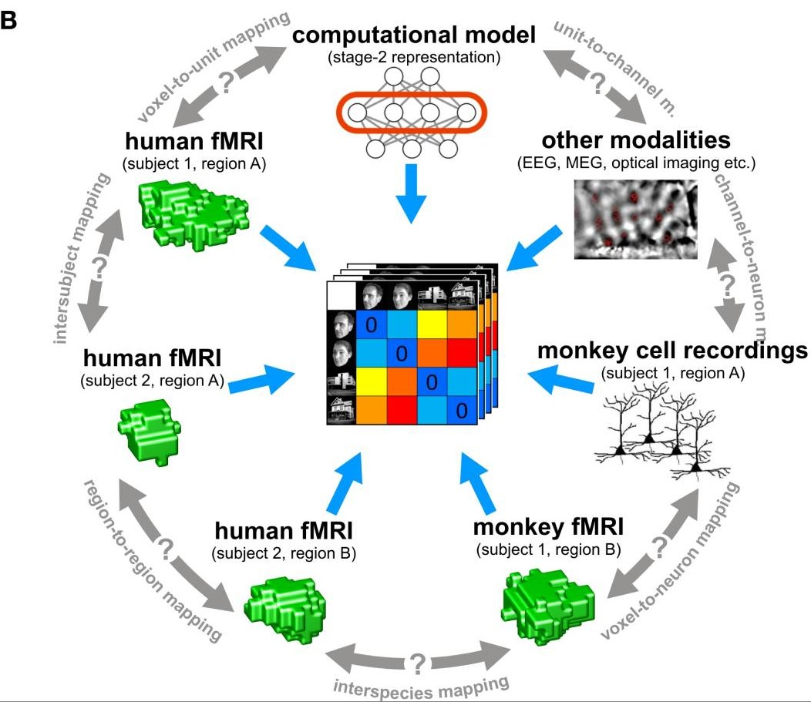
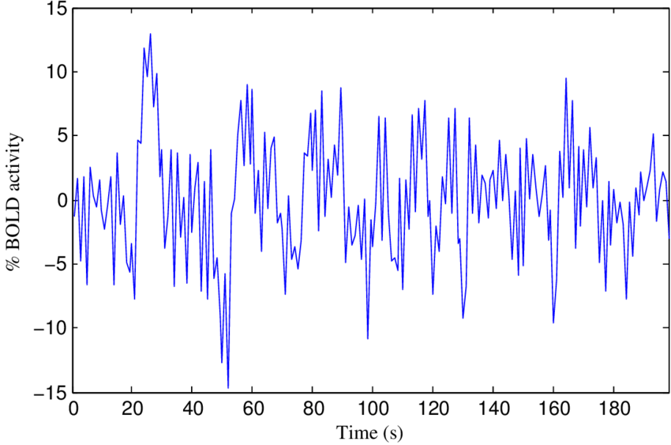
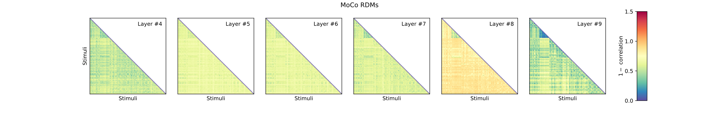
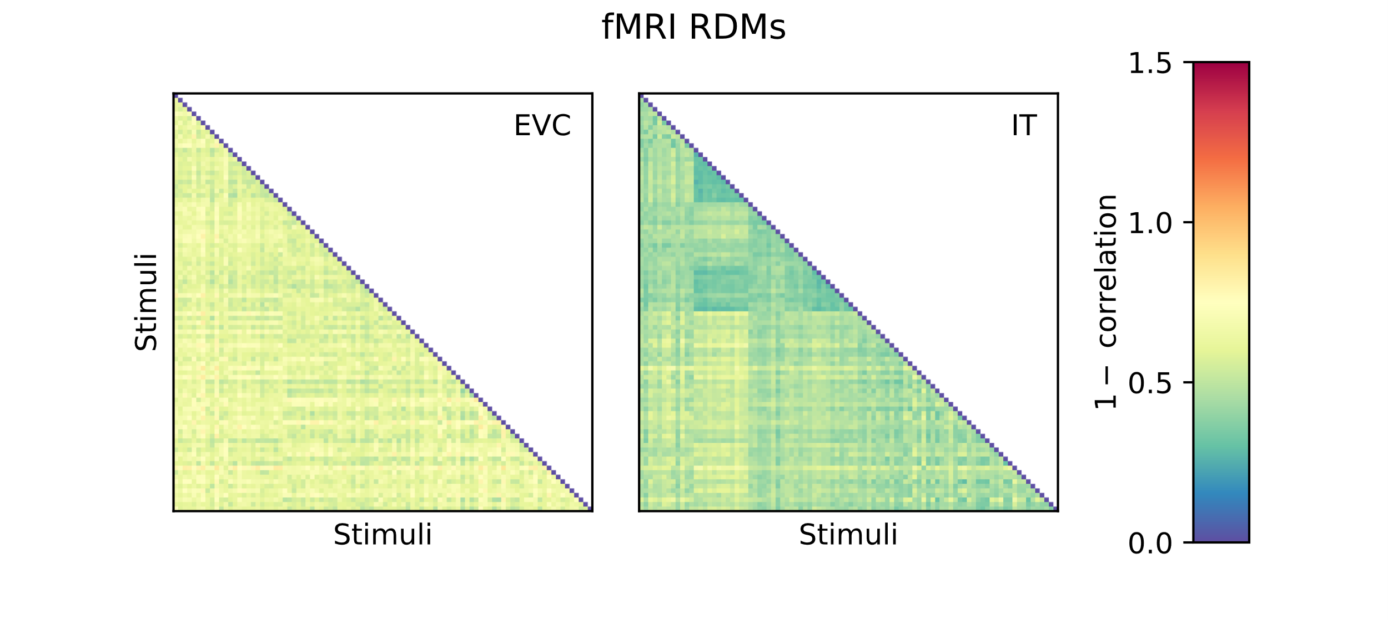
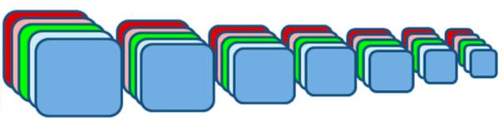
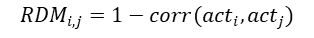
Methodology
Experimental design & data
Representational dissimilarity matrices (RDMs)
Statistical analysis
Stimuli:
How well do different DNNs and DNN layers compare to brain representations?
92 images from 4 categories
92 x 92
$${RDM}_{i,j}=1−corr({act}_{i},{act}_{j})$$
ROIs:
Brain measurements
Correlation
RDMs of fMRI ROIs
← Spearman’s r →
EVC
RDMs DNN
Layer n
RDM fMRI
IT
fMRI BOLD signal
RDM EVC
RDM IT
Variance explained
Activation layers of DNNs
RDMs of activation layers of DNNs
θ₁ + θ₂ + … + θ_{N} =
| | |
ΔR²₁ ΔR²₂ ΔR²_{N}
Layers: 1 … N
RDMs DNN
Layer 1
RDMs DNN
Layer 2
RDMs DNN
Layer N
RDM fMRI
AlexNet
ResNet-18, 50, 101, 152
MoCo
Layers
1...N
Layers
1...N
Layers
1...N
RDMs AlexNet
RDMs ResNet
(18, 50, 101, 150)
RDMs MoCo
Overall R²

Slide 5
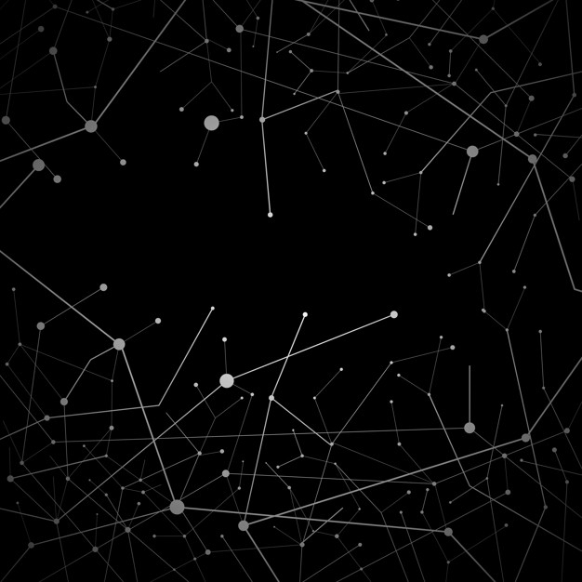
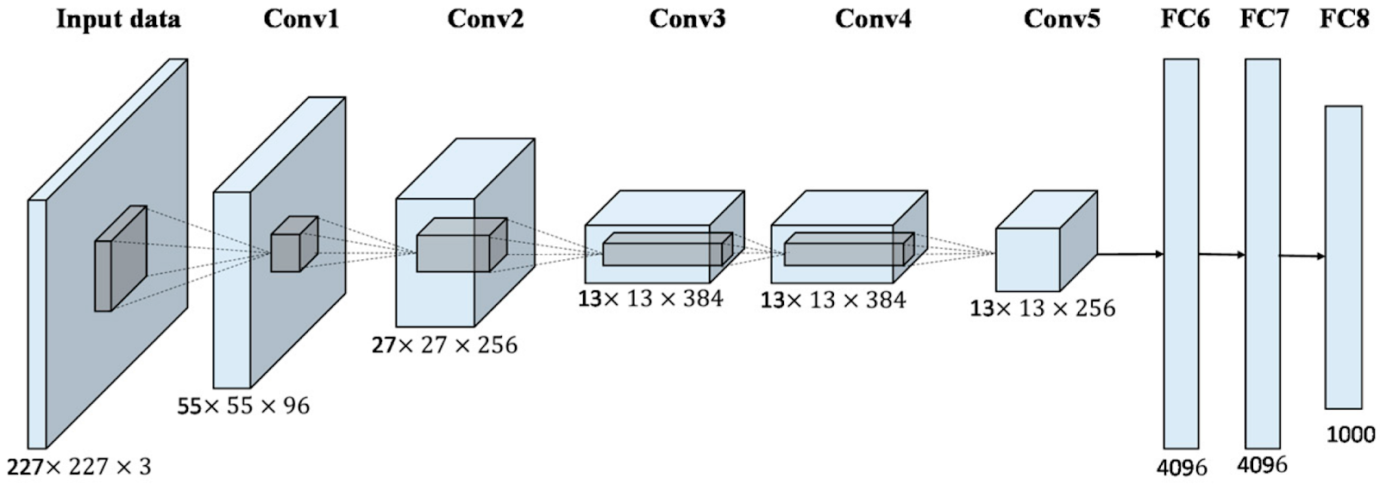
AlexNet

Slide 6
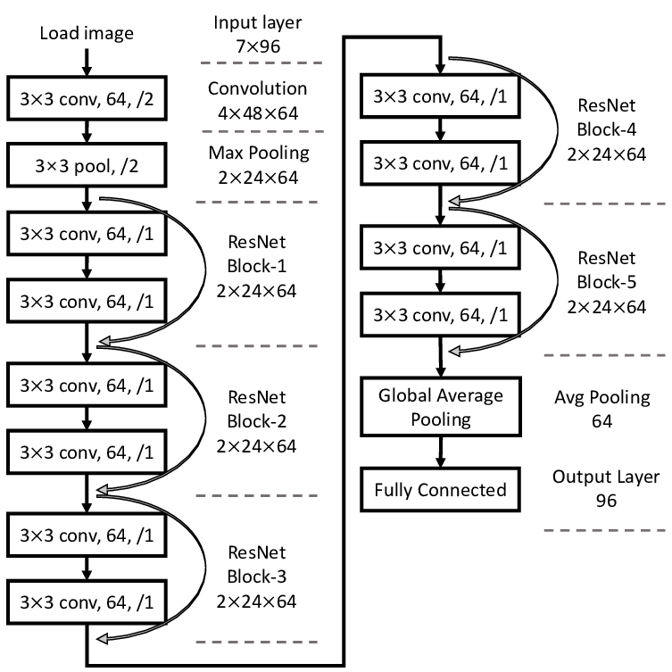
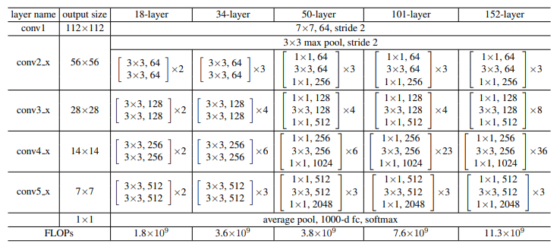
ResNets
Residual Neuron Networks
He, K. et al. 2015

Slide 7
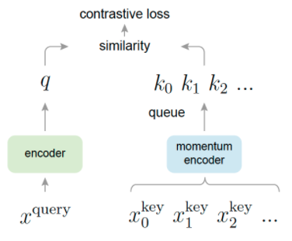
MoCo
Momentum Contrast
Based on
ResNet-50
He, K. et al. 2020

Slide 8
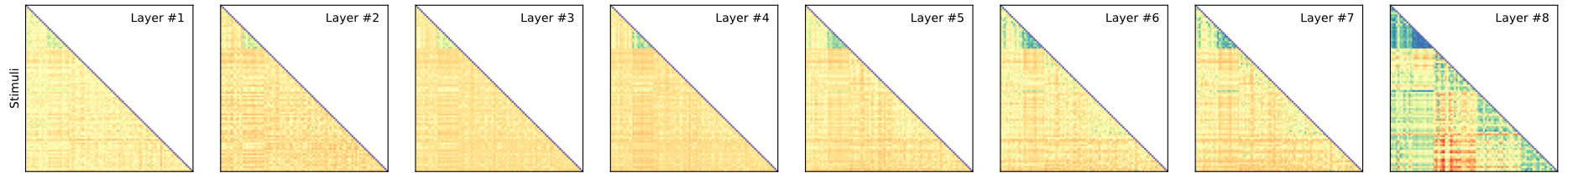
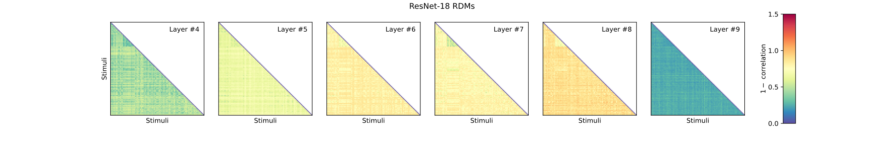
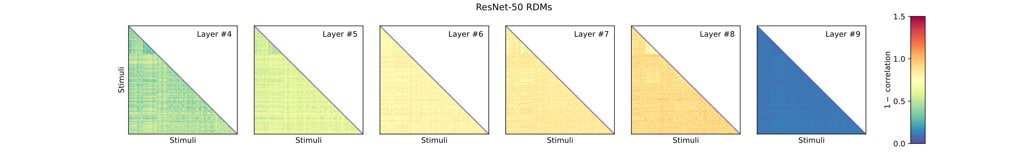
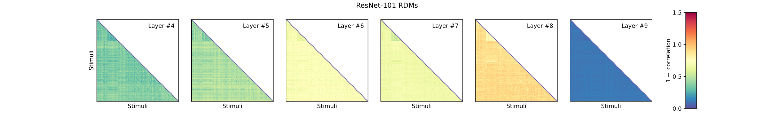
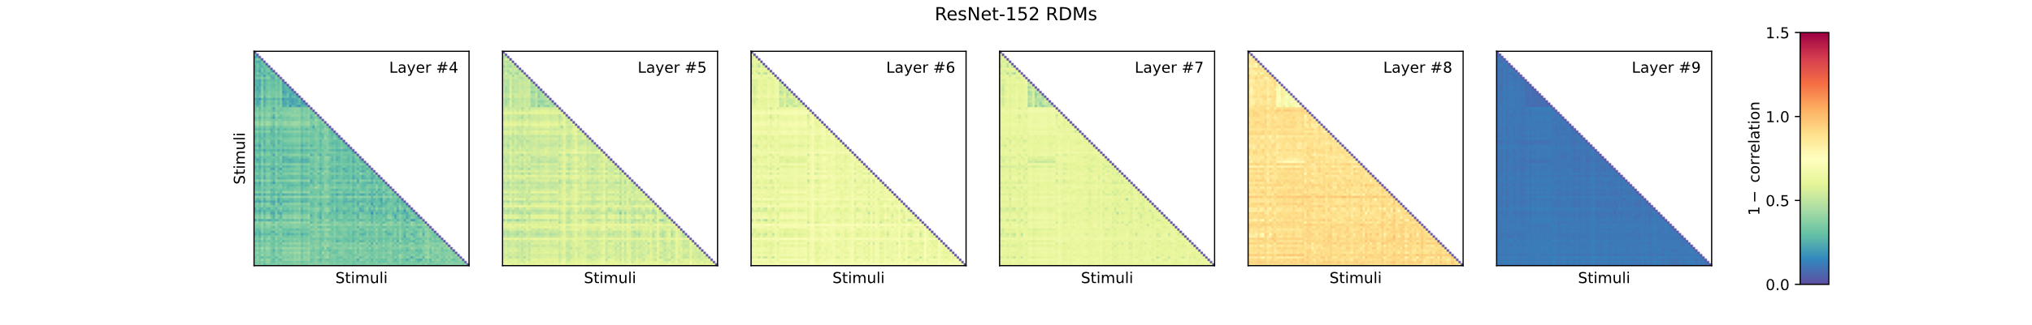
AlexNet
Resnet-18
EVC
Resnet-50
Deep Neural Networks
Brain regions
Resnet-101
IT
Resnet-152
MoCo

Slide 9

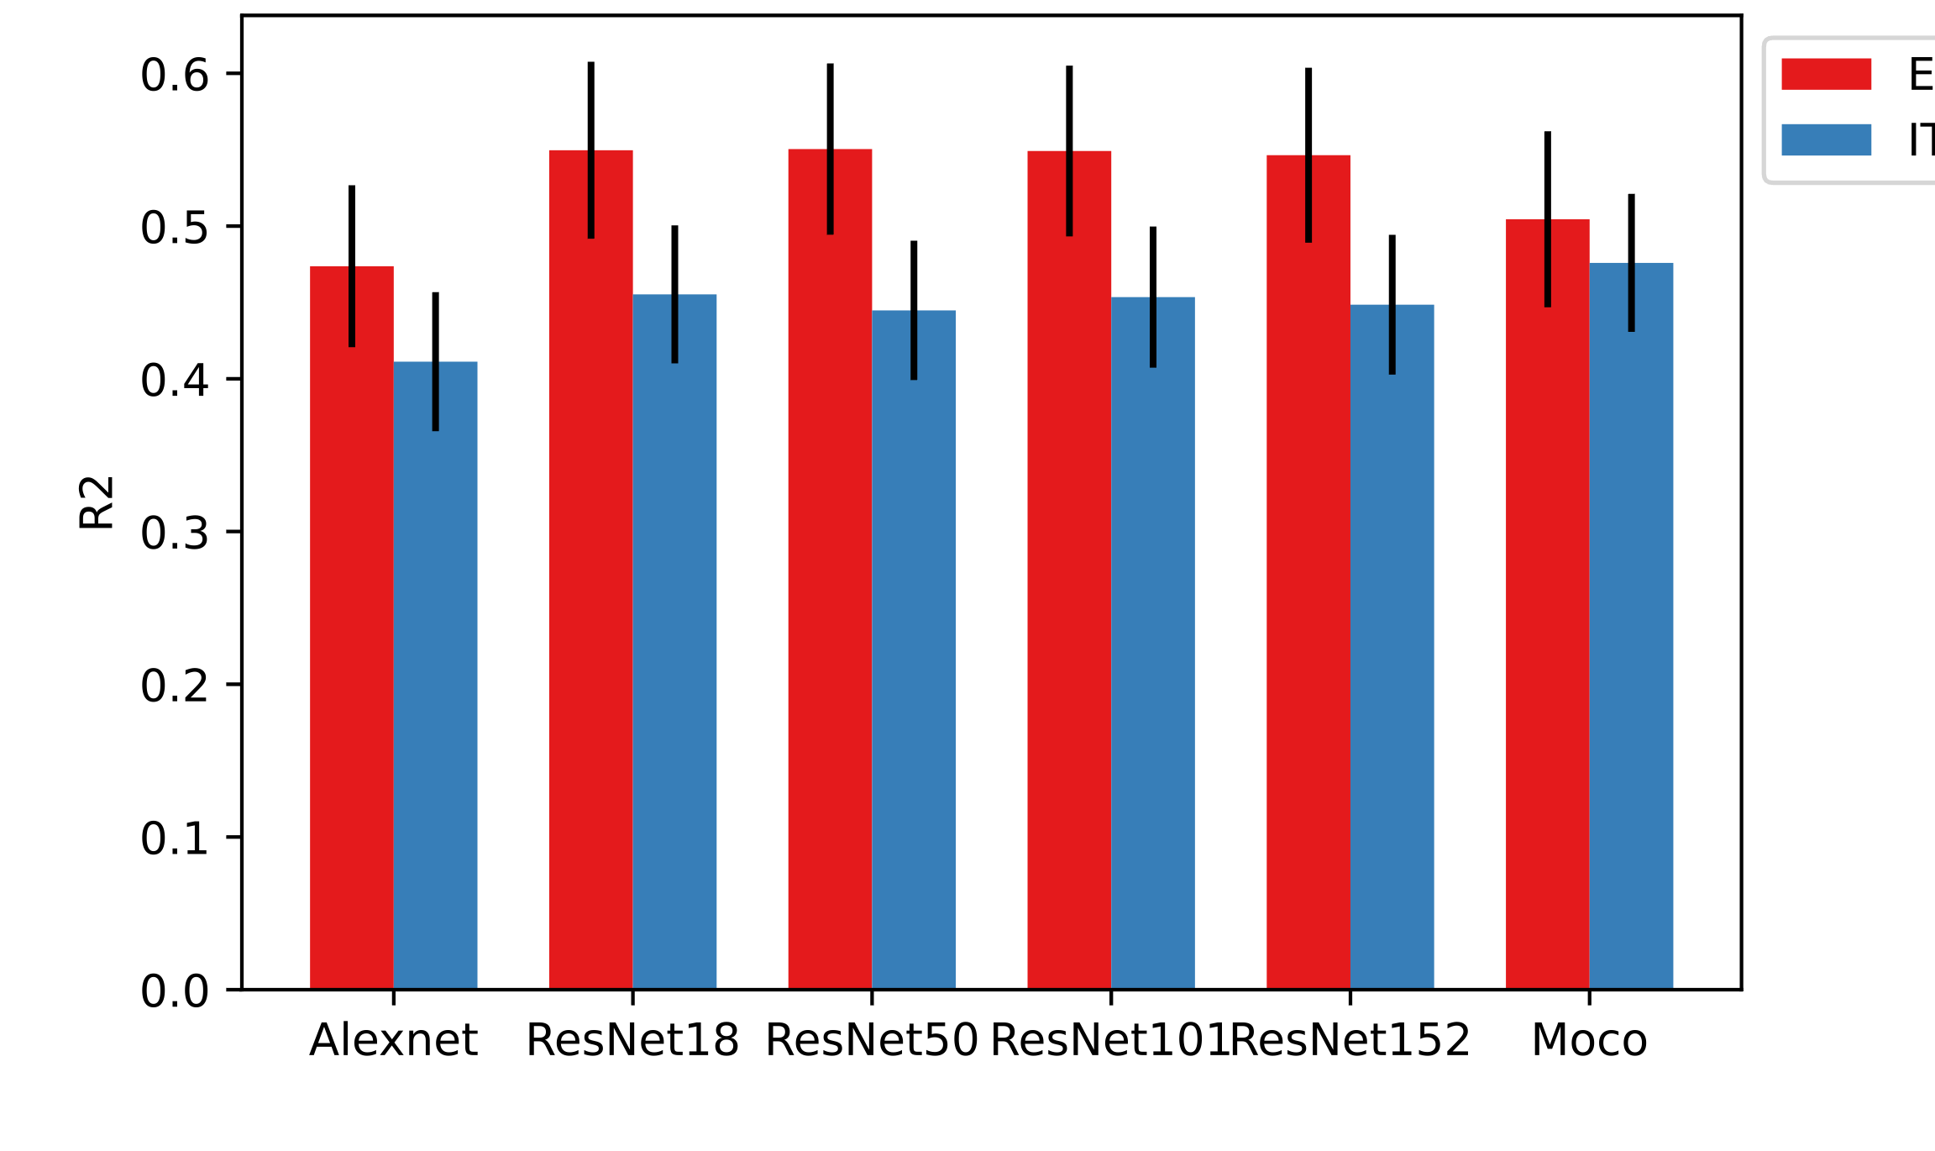
Results
Total variance explained per DNN
EVC
IT
AlexNet RN-18 RN-50 RN-101 RN-152 MoCo

Slide 10
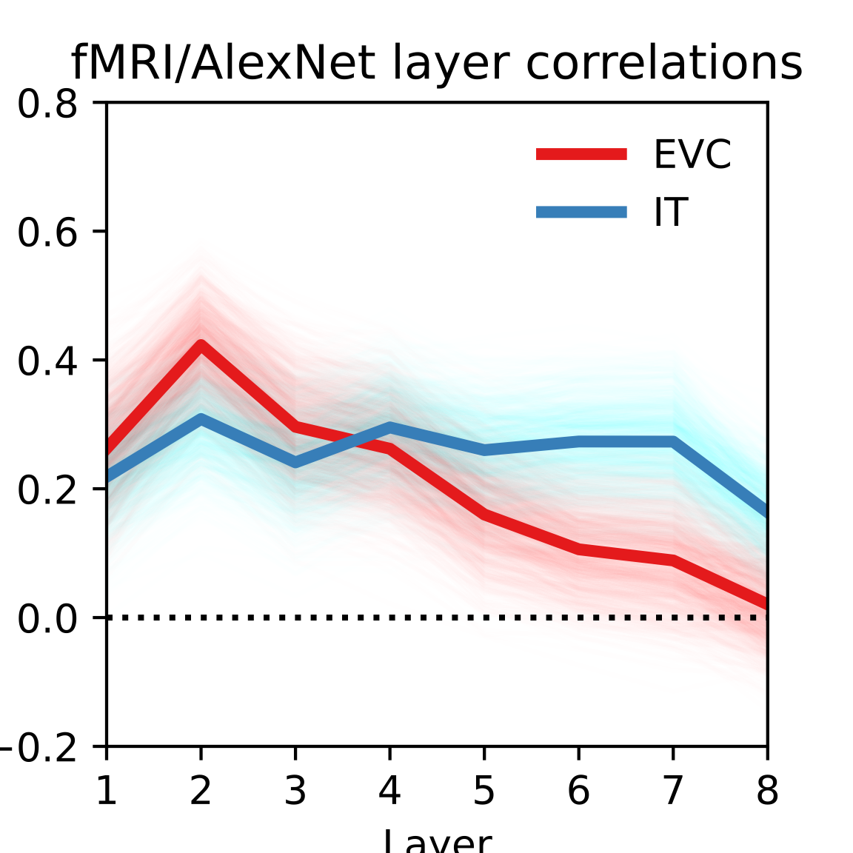
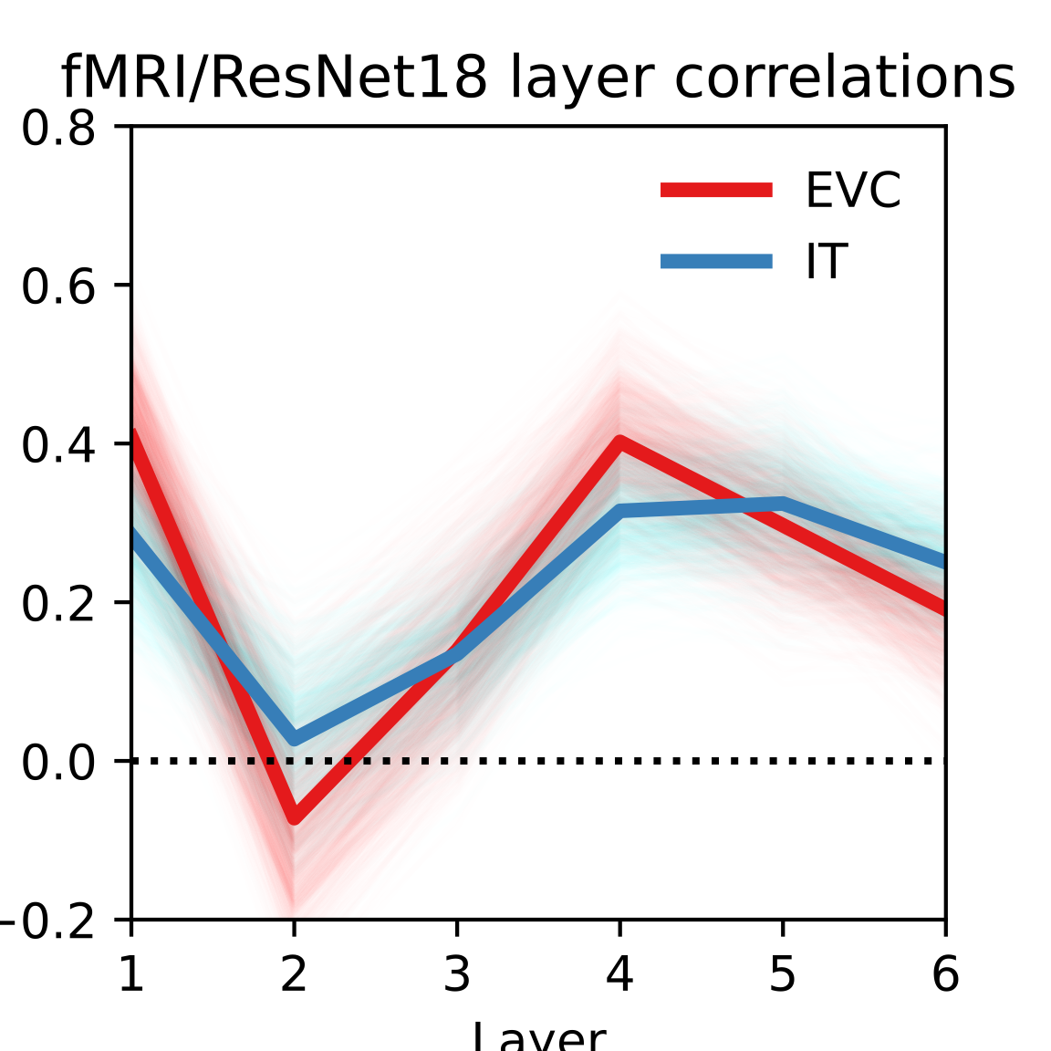
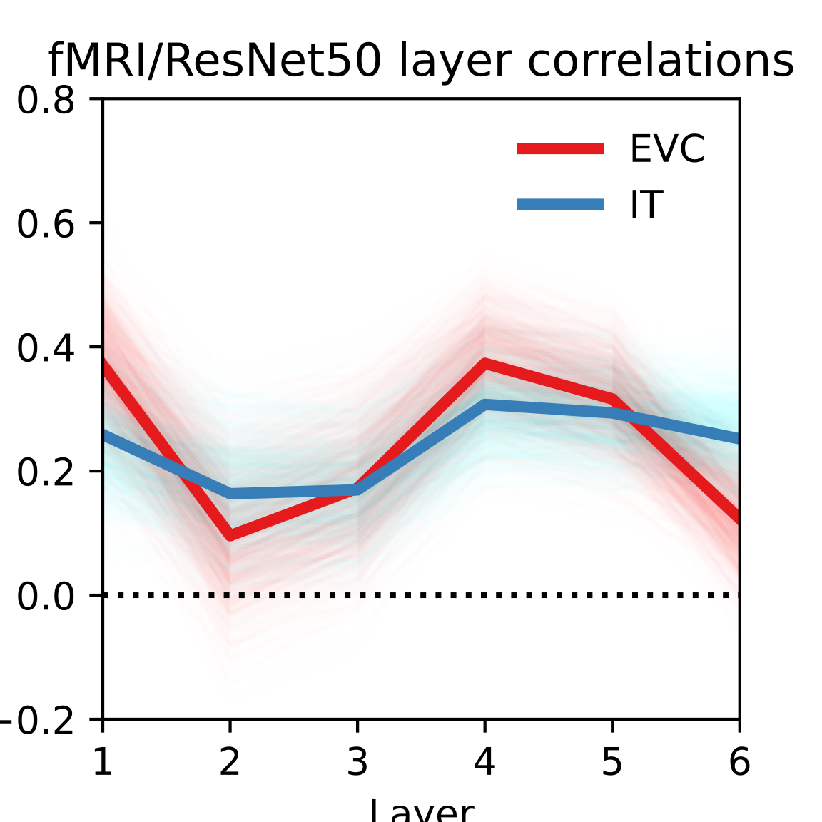
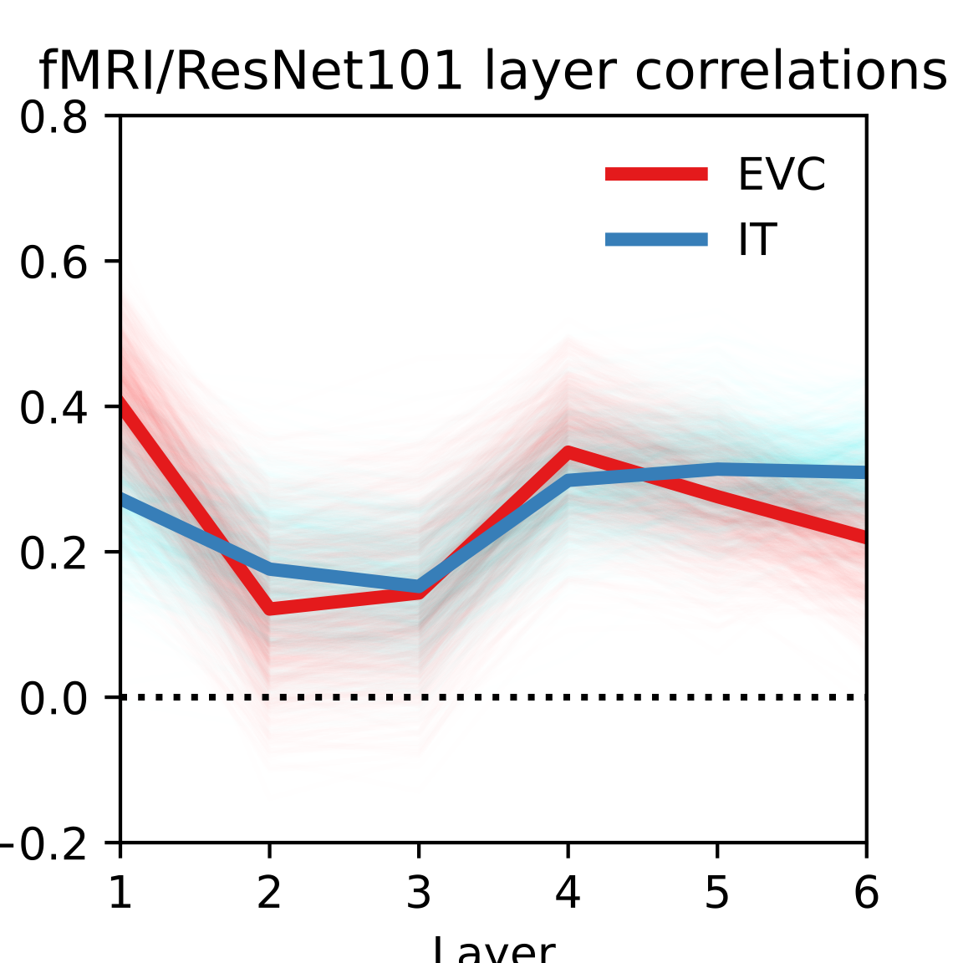
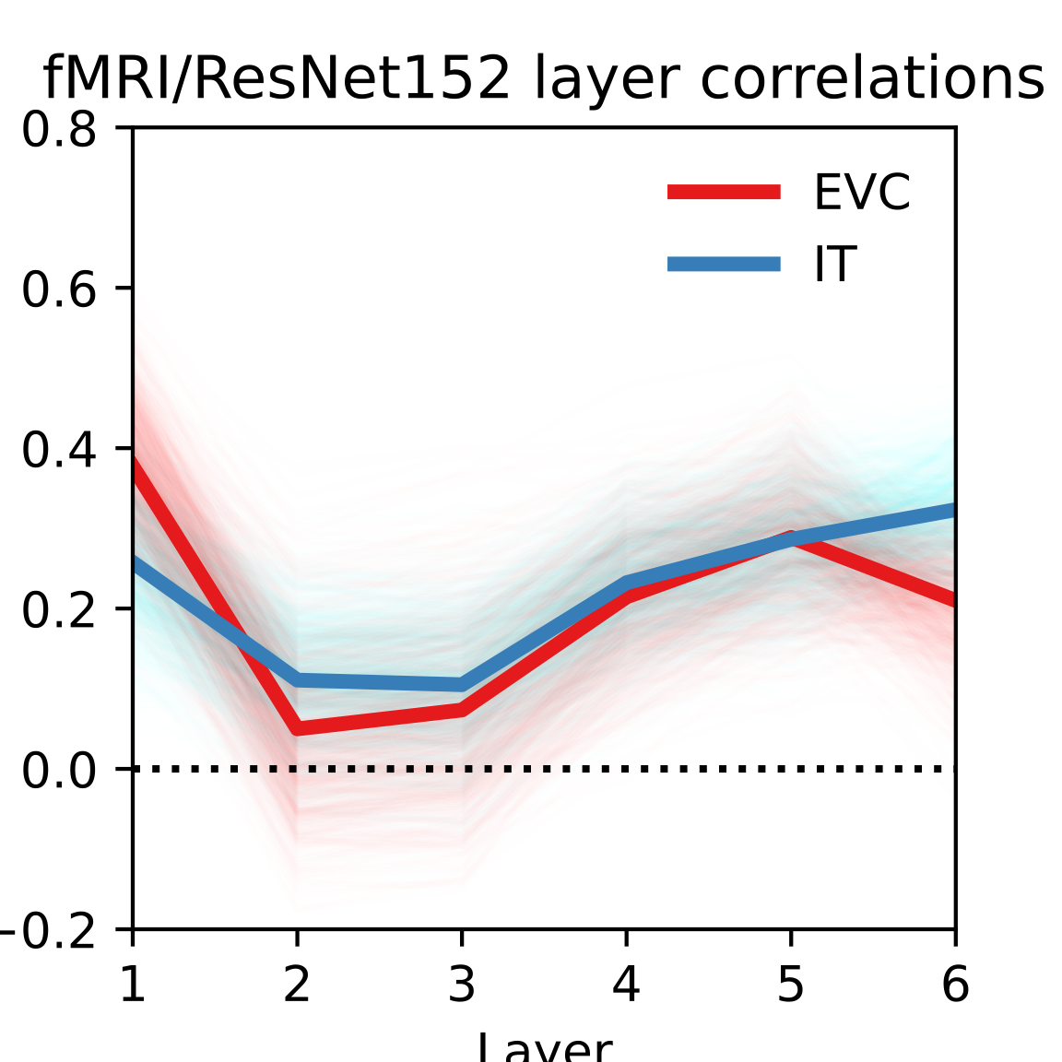
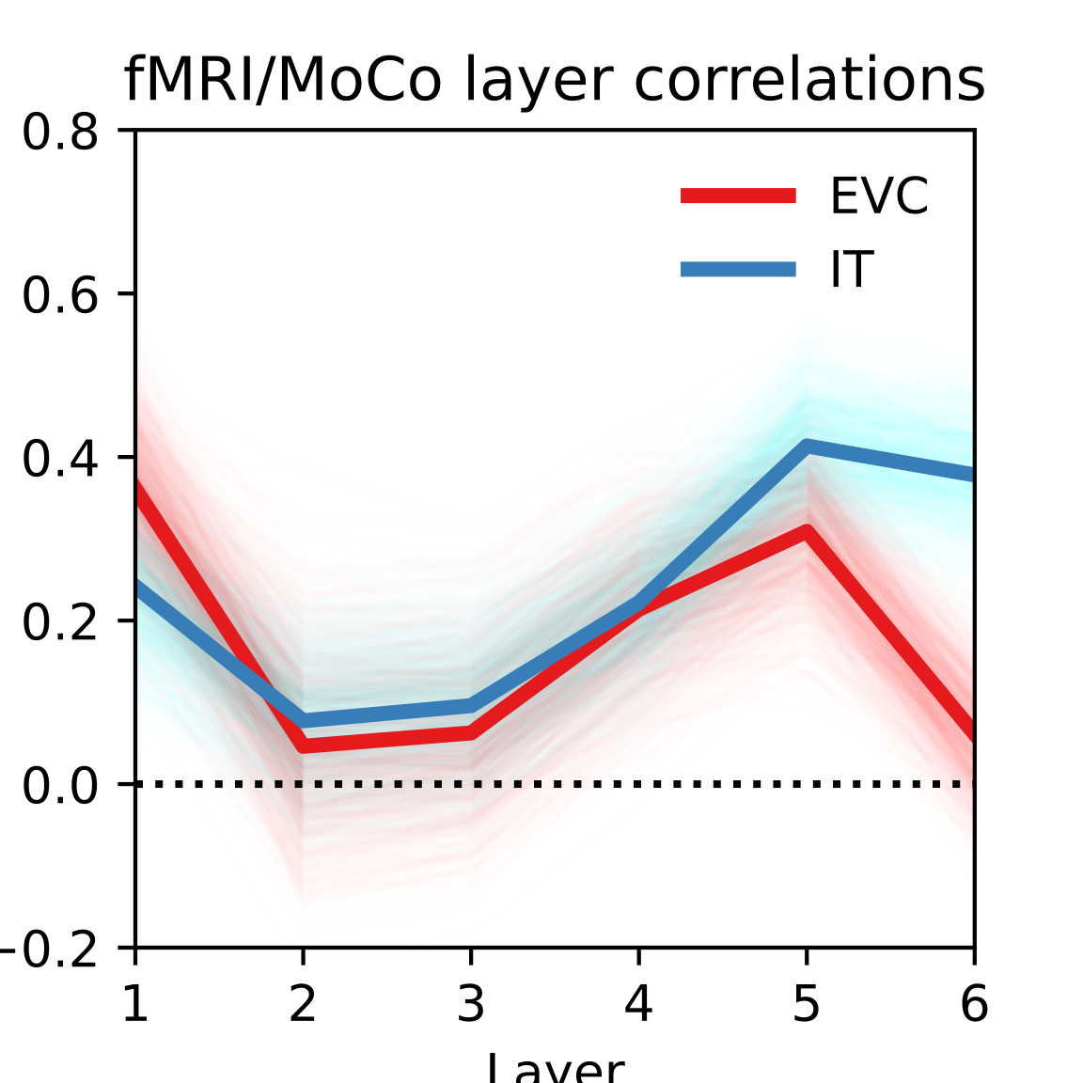
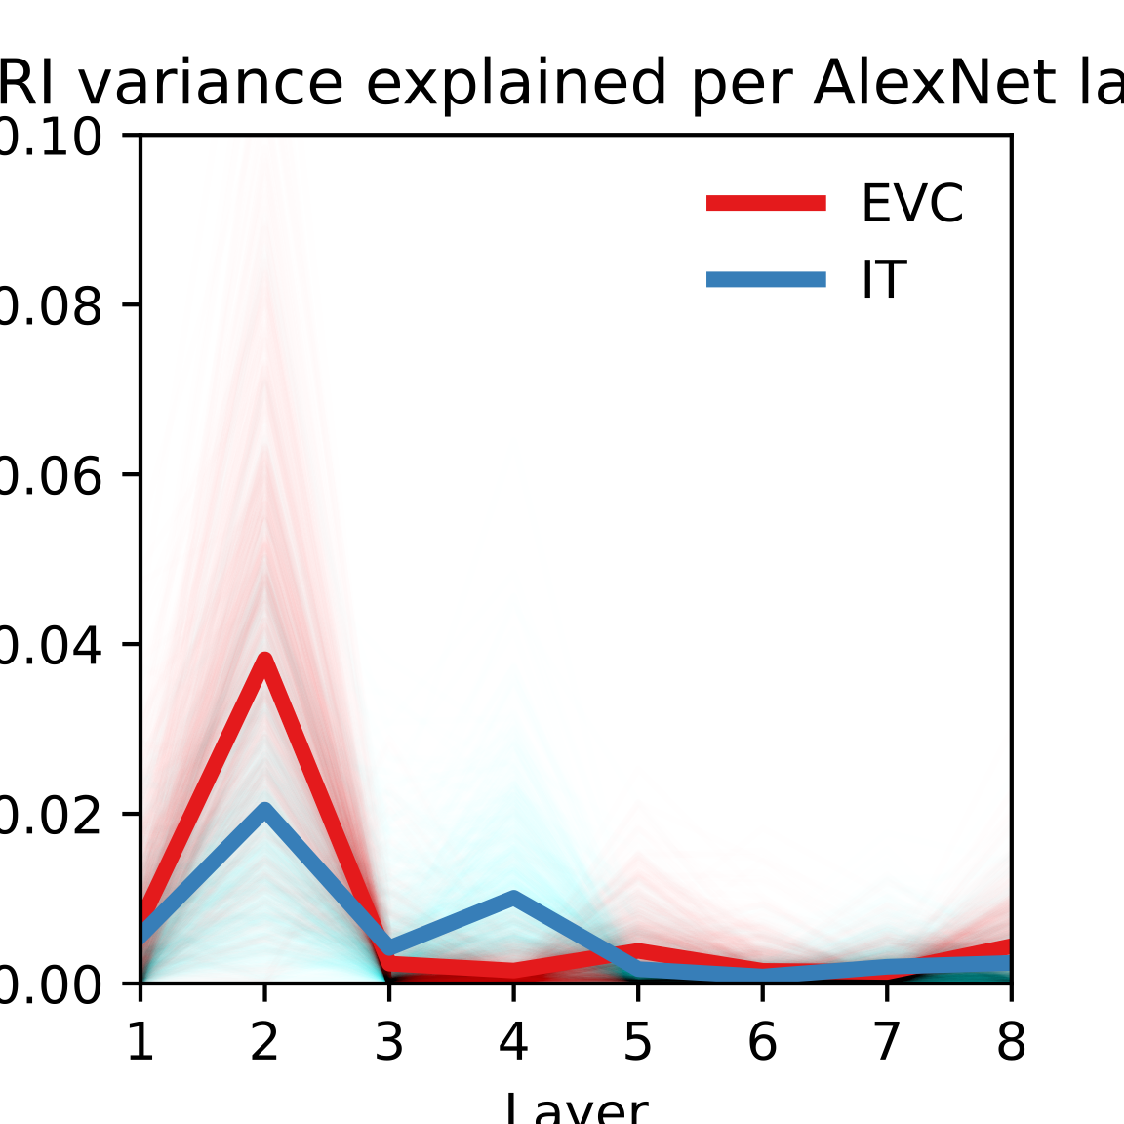
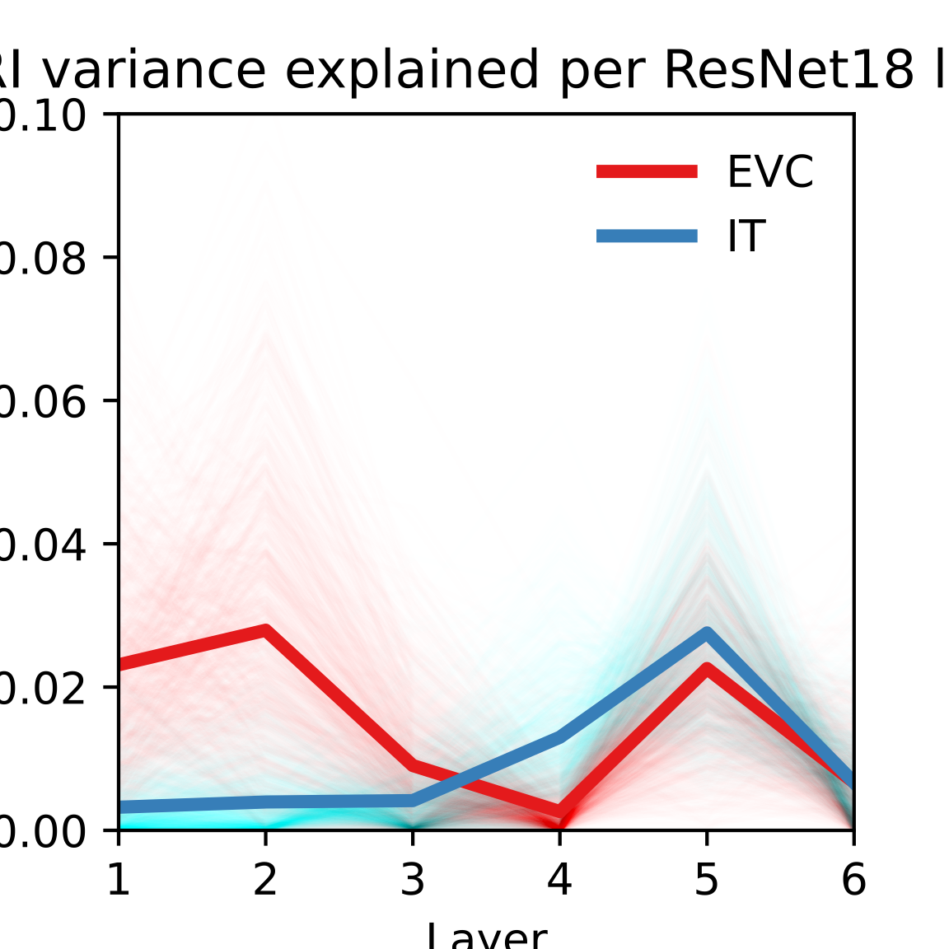
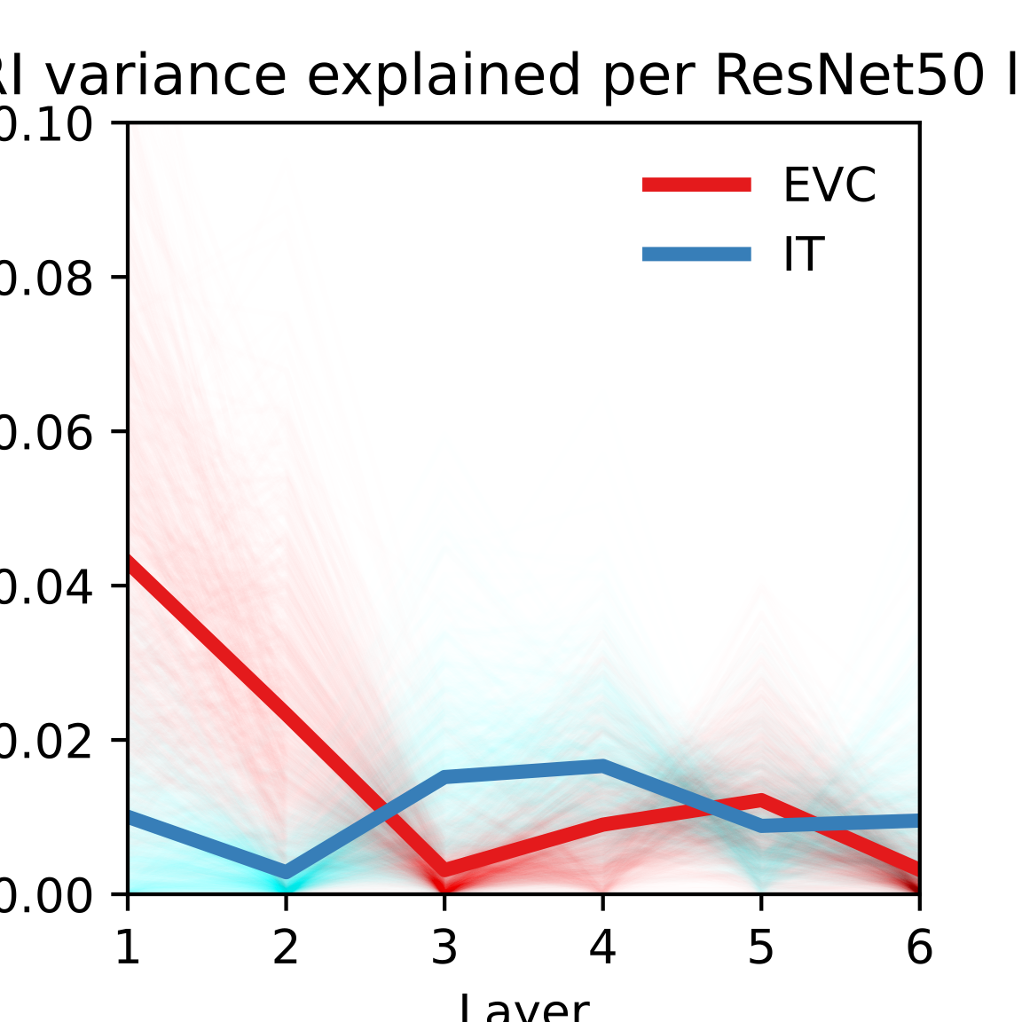
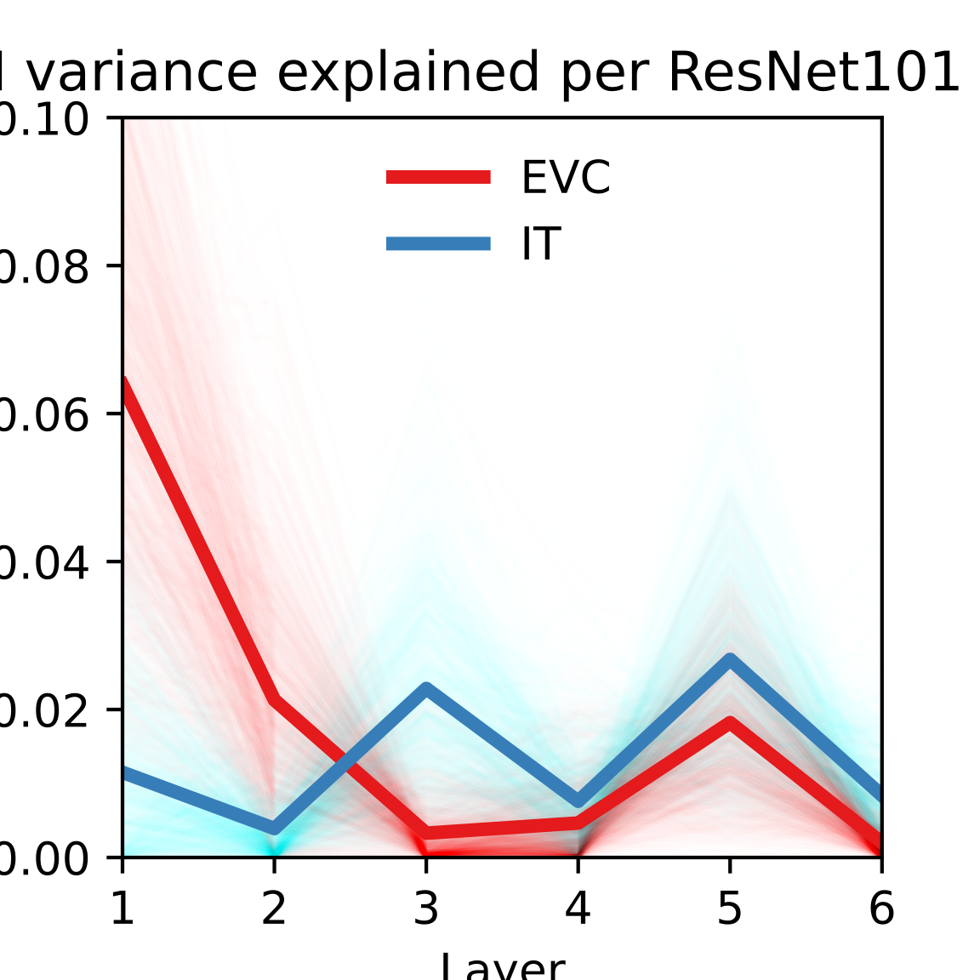
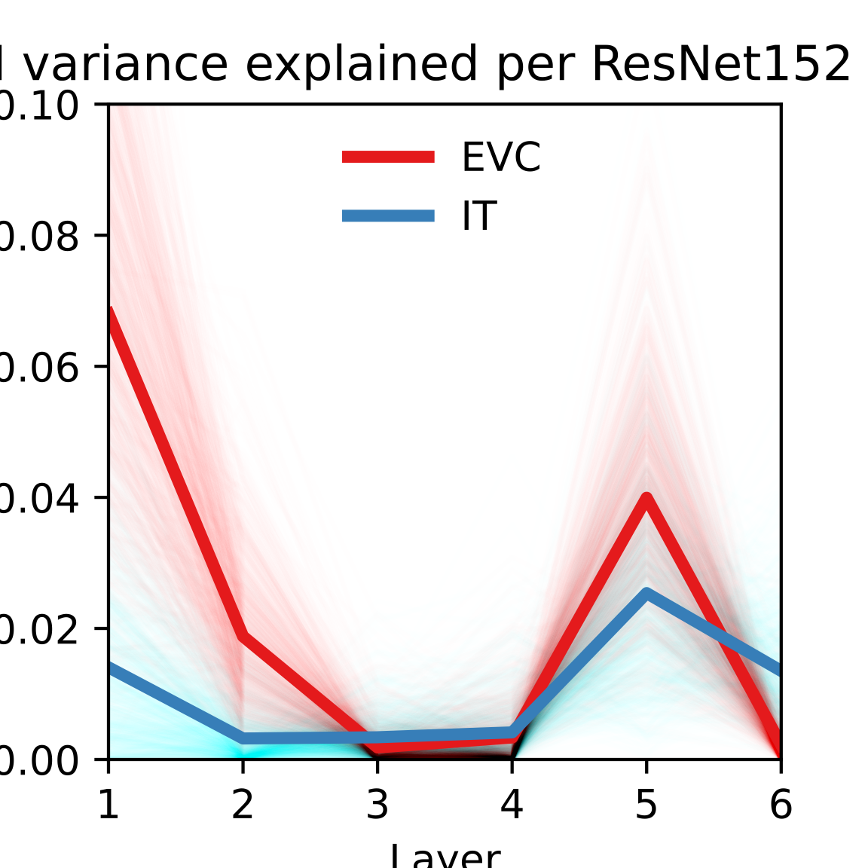
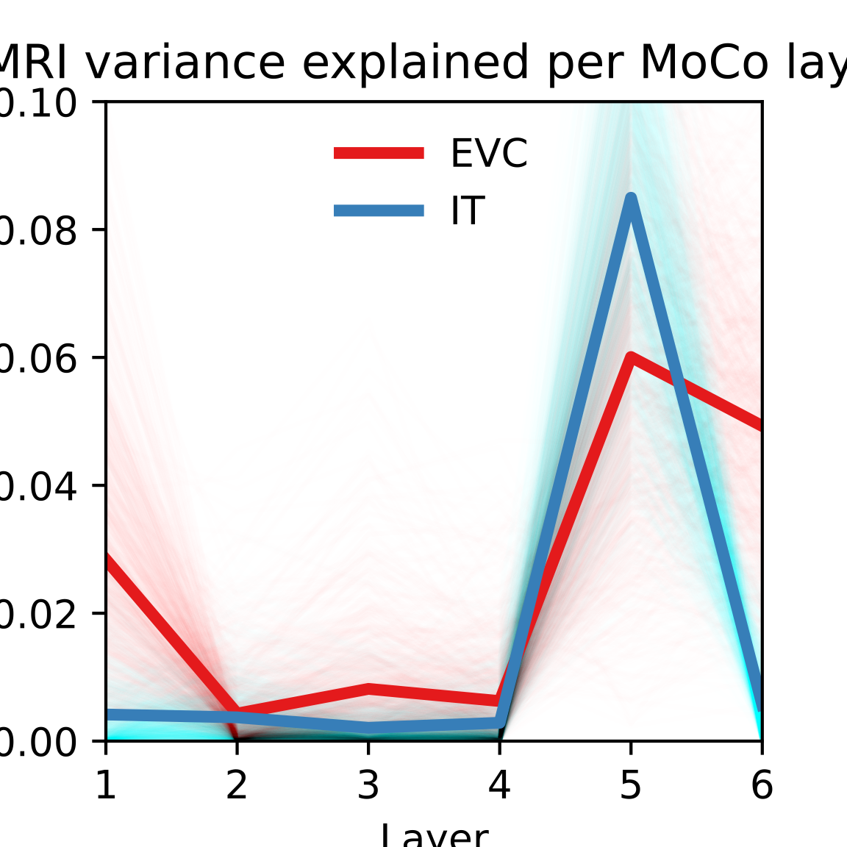
Results
Correlation per DNN layer
AlexNet | ResNet-18 | ResNet-50 | ResNet-101 | ResNet-152 | MoCo
Variance explained per DNN layer
AlexNet | ResNet-18 | ResNet-50 | ResNet-101 | ResNet-152 | MoCo

Slide 11
Conclusions
As we expected, we can see a tendency in which early layers of the DNNs show a stronger relationship with EVC and late layers for IT.
ResNets show a slightly better description of EVC than the other networks, while MoCo does it for IT.
The new neural networks we compared varied in (a) depth of the layers – ResNets from 18 to 152 – and in (b) learning processes –supervised and self-supervised (MoCo). Even if we can see differences between the deeper networks, the results don’t align with the depth but with other unknown parameters. The self-supervised framework of MoCo did show a stronger tendency to correlate with both IT and EVC, especially with IT.
For further research, we suggest a new statistical analysis to find the significance of differences between DNNs.
Notes:
Exceptions for number 1. deep layers explaining EVC, like ResNet152 and Moco.
3. This might because of how labels affect the deeper layers in supervised learning.
4.

